Slide 1
Global Secure Access Quick Demo
Azure Insiders
27. marts 2025

Slide 2
Agenda
What is Global Secure Access
Pros
Cons
Demo infrastucture
Demo

Slide 3
What is Global Secure Access
Cloud Based Security Service Edge (SSE) designed to secure access to Internet Resources and Private Applications
Microsoft Entra Internet Access (Secure Web Gateway)
Microsoft Entra Private Access (focus for today)
Zero Trust Network Access (ZTNA)
No user, device or network is trustworthy -> verification for every access request
Nerver trust, always verify
SSE : framework that combines network security services into a cloud-based platform. Ex. Secure Web Gateways (SWG), Firewall-as-a-service (FWaaS) and Zero Trust Network Access (ZTNA) etc. into a unified solution

Slide 4
Pros
Pros
Zero Trust Network Access (ZTNA)
No user, device or network is trustworthy -> verification for every access request
Nerver trust, always verify
Simple deployment
Everything is setup in Azure and the GSA Client is deployed using Intune
Simple management
Every change is done in Azure -> No changes needed on the clients
Granular Access Control
Users/groups and Conditional Access per application/network
Detailed logs and dashboards making troubleshooting easier
Can coexist with existing solutions like AlwaysOn VPN making transition smooth
For hybrid joined devices having both solutions can sometimes make sense

Slide 5
Cons
Licensing
P1 (eller P2) with ”Microsoft Entra Private Access” addon license
Licensing is per user

Slide 6
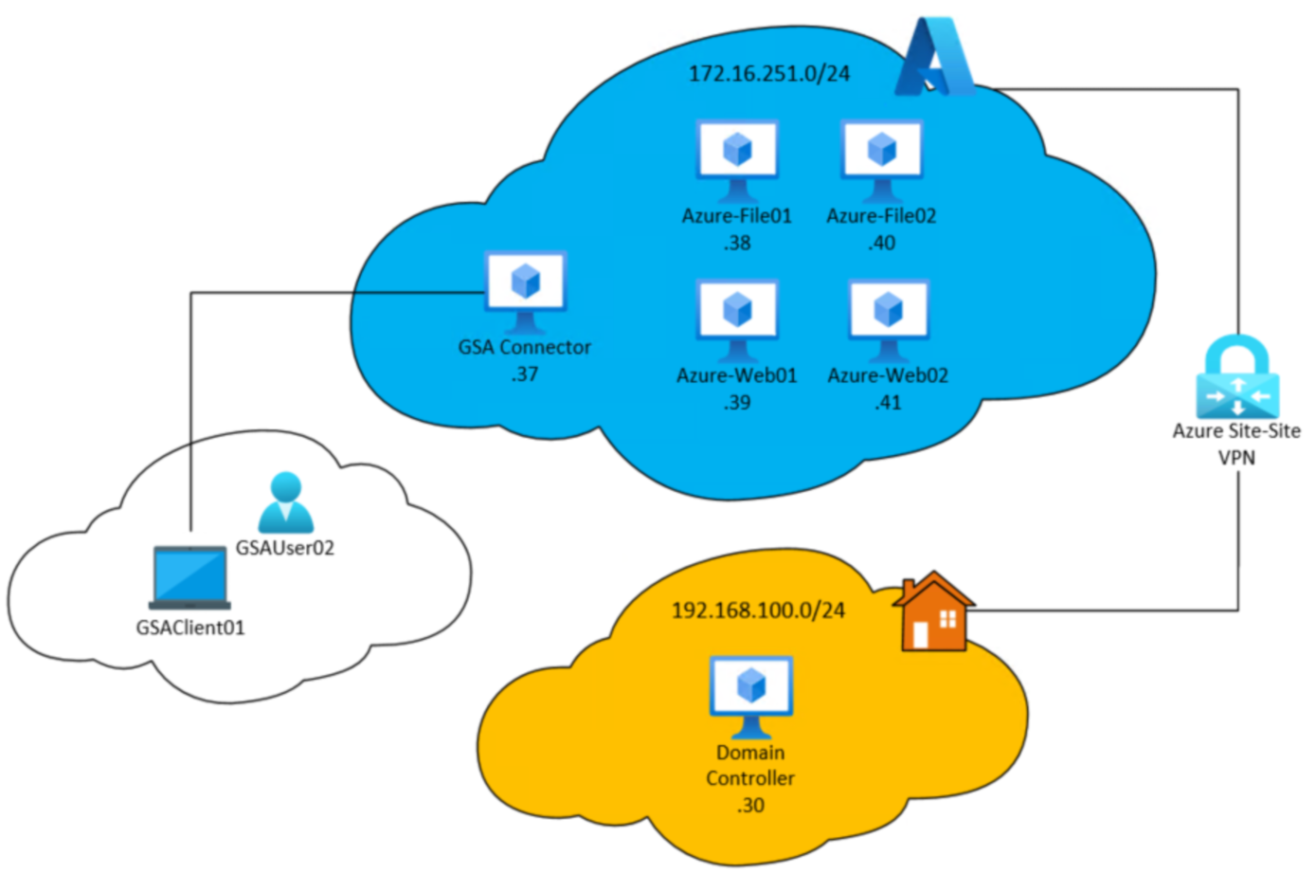
Demo infrastructure
Azure
GSA Connector
Services (Web & Fil)
OnPrem
Domain Controller
Client
Non-admin bruger
Entra Connect configured

Slide 7
Demo
What it looks like from an users perspective
Client Status
Client Advanced Diagnostics
Health Check, forwarding profile & troubleshooting
Admin through https://entra.microsoft.com
Connectors, traffic flow
Application configuration
IP/Ports/Networks/CIDR/FQDN/Protocols (no ICMP!)
Users
Conditional Access
Private DNS
DNS flow

Slide 8

Questions
Notes:
De følgende slides går i detaljer med aktiviteter som KUNNE være relevant for kunden.

